Slide 1
Final Project Wordle Replica
by: Ethan Kirchner, Grace Ngo, and Zechariah Burrus

Slide 2
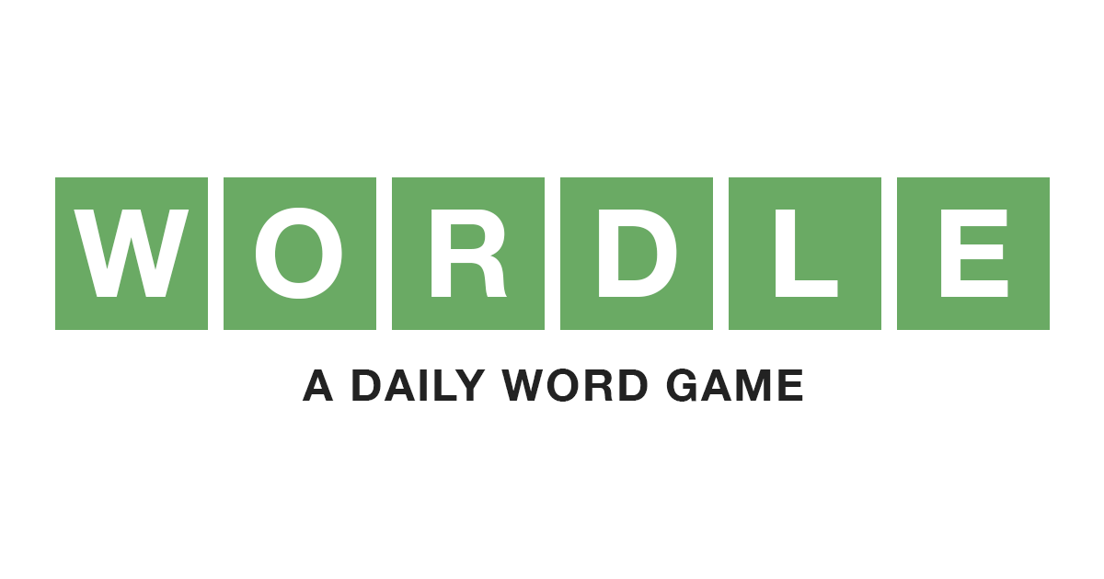
WEEK 1 : Planning
Coding was going to be done using Python
Going to be based around the popular game Wordle (single player, multiple users on one server)
Split everyone up into their respective roles
Ethan: Outlining the project and designing the architecture
Zechariah: Primary programming portion of the project
Grace: Make a collection of words to use for wordle and handling UI design, testing

Slide 3
WEEK 2 : Mapping
Spent time working out what the server/client programs would look like and contain
Prototype of Project.txt (in GitHub)
Created the word list we would use to generate random 5-letter words
Had general meetings with one another throughout the week to finalize our plan

Slide 4
WEEK 3 : Programming
Finalized the word list, imported it into the game to use
wordList.txt (in Github)
Spent time together to not only write out the logic and physical code, but to test it out as well
Ethan and Zech worked together on the coding, Zech and Grace did the testing
Made very good progress overall
Given that the logic testing went so well, we felt confident that we would be able to finish everything efficiently

Slide 5
WEEK 4 : Finalizing
Uploaded the client and server files in GitHub
client.py and server.py (in GitHub)
Ran final logic tests and general troubleshooting to ensure quality and efficiency of the game
Covered details such as colors and overall formatting
Individually ran tests of the game

Slide 6
W
O
R
D
L
E
Guess the 5 letter word within 6 tries!
T
E
A
R
Y
If the player guesses a letter correctly in the correct spot, the letter will turn cyan
P
R
U
N
E
If the player guesses a letter correctly in the wrong spot, the letter will turn yellow
D
R
I
F
T
If the player guesses a letter incorrectly, the letters will not change colors

